Slide 1
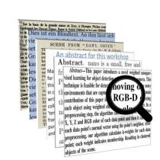
Classiﬁcation of Multi-Labeled Text Articles with Reuters Dataset using SVM
Jaivik Vaghani

Slide 2
Agenda
Introduction
Machine Learning Algorithms
SVM
Data set
Data Cleaning & Pre - Processing
Feature Extraction
Classifier
Result
Future Work
Summary
Conclusion
References

Slide 3
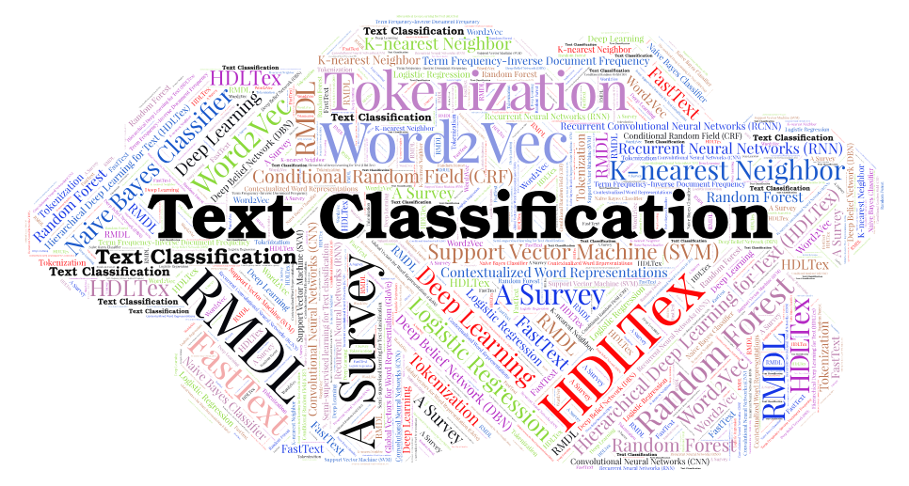
What is Text Classification?

Slide 4
Introduction
Text classification is the process of categorizing text documents into pre-defined categories or classes based on their content.
Text classification offers a way to analyze and extract insights from this vast amount of textual information.
Text classification provides an automated way of organizing and understanding the vast amount of textual data that is generated every day, making it an essential tool for data-driven decision making in various industries.

Slide 5
Introduction
Text classification is a type of natural language processing (NLP) task that involves assigning a label to a piece of text. The label can be a category, such as "news article" or "product review," or it can be a sentiment, such as "positive" or "negative.“
Text classification is important because it allows us to organize and make sense of the vast amount of text data that is available online. For example, text classification can be used to automatically categorize emails, or to route customer support tickets to the appropriate department.

Slide 6
Machine Learning Algorithms
There are the following Machine Learning Algorithms can be used for this project:
KNN
Decision Trees
Bagging
Random Forests
Boosting
Multinomial Naive Bayes
Support Vector Machine (SVM)

Slide 7
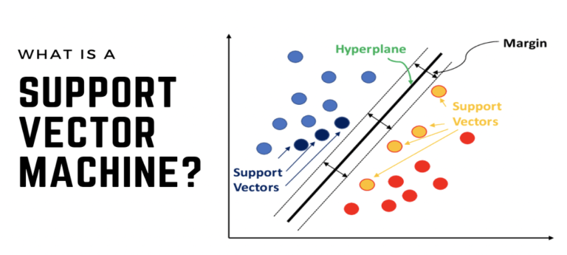

Slide 8
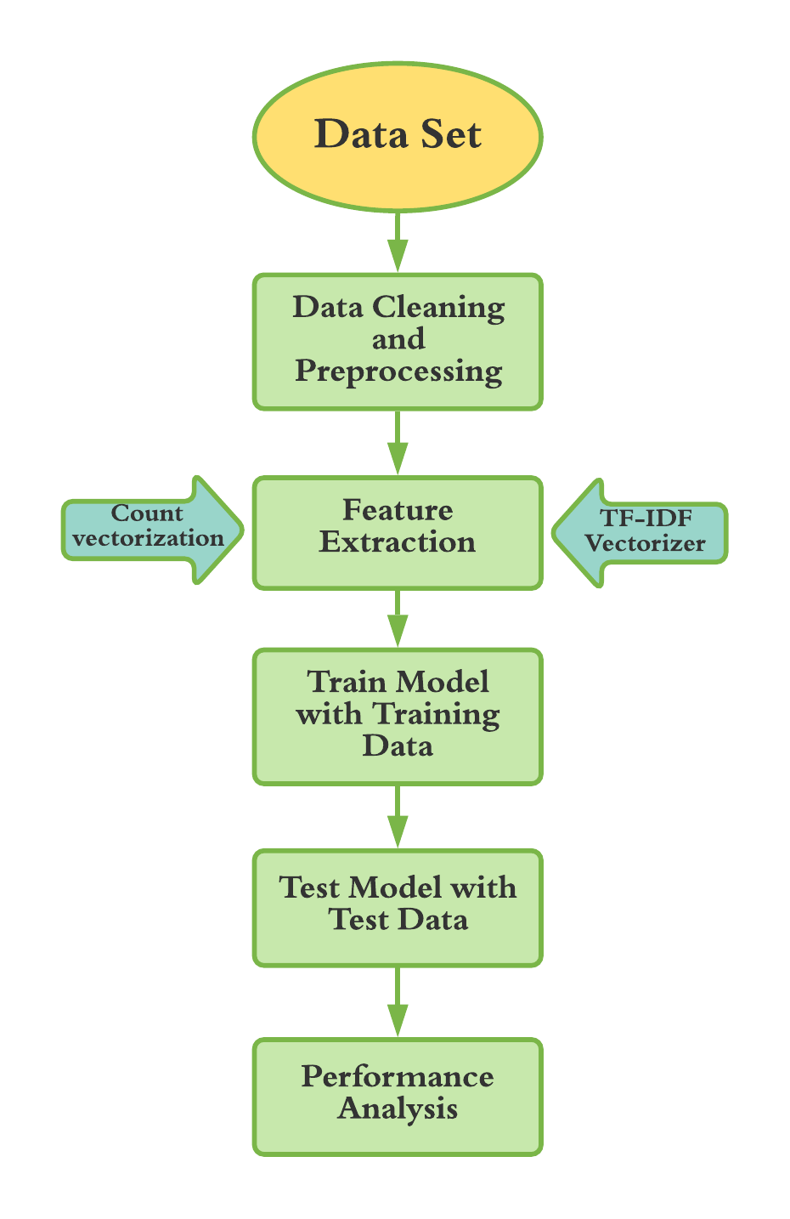
Dataset
Reuters-21578
.The Reuters-21578 benchmark corpus is a widely used collection of newswire articles used in natural language processing research.
The ApteMod version of the Reuters-21578 corpus contains 21,578 documents, each of which is assigned one or more topic codes from a predeﬁned set of categories.
The categories cover a wide range of topics, including business, ﬁnance, politics, and sports.
https://www.kaggle.com/boldy717/reutersnltk?select=reutersNLTK.xlsx

Slide 9
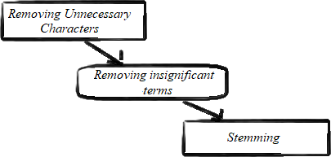
Data Cleaning & Preprocessing
Original data needs a lot of pre-processing to extract relevant data for meaningful classification.
Dataset is prepared for the classiﬁer algorithms after deleting the punctuation marks, numerical values, special symbols, stop-words, and steaming.
Stemming: Stemming is the process of obtaining or extracting just the root of any given word. For example, ‘studies’ becomes ‘studi’, ‘studying’ becomes ‘study’, ‘studied’ becomes ‘studi’.

Slide 10
Data Cleaning & Preprocessing
For the purpose of the project, I ﬁrst remove all the end spaces, and then remove all the special characters.
After doing this, I remove all the stopwords from the text.
The next step is to perform Lemmatization to obtain the original dictionary form of each of the words in the remaining text.
Finally, I do tokenization of the data.

Slide 11
Feature Extraction
Count Vectorizer is a simple and efficient way to represent text data. It is often used as a baseline for text classification experiments. However, Count Vectorizer can be sensitive to the presence of stop words (common words that do not carry much meaning, such as "the" and "a").
TF-IDF Vectorizer is a more sophisticated way to represent text data. It takes into account the frequency of words in the corpus, as well as the number of documents that contain the word. This makes TF-IDF Vectorizer more robust to the presence of stop words. However, TF-IDF Vectorizer can be more computationally expensive than Count Vectorizer.

Slide 12
Feature Extraction
The choice of which vectorizer to use depends on the specific machine learning algorithm and the dataset. For example, if you are using a simple machine learning algorithm, such as a decision tree,
Count Vectorizer may be sufficient. However, if you are using a more complex machine learning algorithm, such as a support vector machine, TF-IDF Vectorizer may be a better choice.

Slide 13

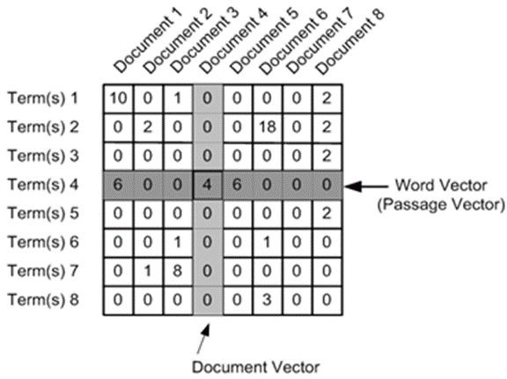
TF-IDF
Term Frequency – Inverse Document Frequency or TF-IDF is a basic natural language processing technique
To obtain the vector or numeric representation of corpus or textual data.
Wᵢⱼ is the TF-IDF score obtained for each term i in the document j. tfᵢⱼ is the term frequency for ‘I’ in ‘j’, and idfᵢ on the other hand is its IDF score.

Slide 14
Classiﬁer
SVM is a supervised learning algorithm that can be used for both classification and regression tasks. It works by finding the hyperplane that best separates the two classes of data.
The kernel technique is a way of transforming the data into a higher dimensional space where the classes are more linearly separable. This is often done using the Gaussian kernel, which calculates the similarity between two data points based on their distance in the original space.
The linear kernel is the simplest kernel and works well when the classes are linearly separable. However, if the classes are not linearly separable, a more complex kernel, such as the polynomial kernel, may be necessary.

Slide 15
Results
The data was divided into 2 parts randomly using the train test split module of Scikit-learn. The first half contains 70% of the data needed to train the classifiers, whereas the second part contains 30% of the data required to test the classifiers' effectiveness.
Two different kernels, linear and polynomial, of SVM classifiers have been used for this report to compare the results
. The linear kernel performed better than the polynomial kernel in terms of accuracy and precision.

Slide 16
Results
Based on the model performance, I evaluate and compare the accuracies of each of these models against each other to see which has the highest performance.
I use the following metrics to judge the individual performances of each model:
Accuracy: The percentage of correctly classiﬁed news articles.
Precision: The percentage of true positives out of all predicted positives.
Recall: The percentage of true positives out of all actual positives.
F1 Score: The harmonic mean of precision and recall.
Micro-F1 score is metric calculated as the harmonic mean of precision and recall scores, where both precision and recall are calculated using true positive, false positive, and false negative values for the entire dataset, rather than separately for each class.

Slide 17
RESULTS FOR SVM CLASSIFIER
RESULTS FOR SVM CLASSIFIER WITH LINEAR KERNEL
LINEAR KERNEL
POLYNOMIAL KERNEL
Classes | Precision | Recall | F1-Score | Support
earn | 0.98 | 0.98 | 0.98 | 1178
acq | 0.95 | 0.97 | 0.96 | 711
crude | 0.95 | 0.93 | 0.94 | 166
interest | 0.80 | 0.85 | 0.82 | 136
money-fx | 0.68 | 0.63 | 0.65 | 109
trade | 0.90 | 0.97 | 0.93 | 99
grain | 0.86 | 0.91 | 0.88 | 88
corn | 0.98 | 0.75 | 0.85 | 61
dlr | 0.78 | 0.71 | 0.74 | 51
money-supply | 0.98 | 0.87 | 0.92 | 46
Classes | Precision | Recall | F1-Score | Support
earn | 0.99 | 0.98 | 0.98 | 1178
acq | 0.88 | 0.98 | 0.93 | 711
rude | 0.97 | 0.87 | 0.92 | 166
interest | 0.80 | 0.84 | 0.82 | 136
money-fx | 0.74 | 0.60 | 0.66 | 109
trade | 0.90 | 0.88 | 0.89 | 99
grain | 0.90 | 0.86 | 0.88 | 88
corn | 1.00 | 0.70 | 0.83 | 61
dlr | 0.88 | 0.69 | 0.77 | 51
money-supply | 0.93 | 0.89 | 0.91 | 46

Slide 18
Future Work
We can improve the classiﬁcation by using word embeddings instead of Bag of Words concept.
These word-embeddings can then be supplied for training to advanced Nueral Network models like RNN, CNN, LSTM, etc.
For the purpose of this project, I experimented with a combination of Word2Vec and LSTM for classiﬁcation.
However, the training of LSTM failed multiple times due to computational limitations.
Let us look at these concepts, and understand why such a pipeline can result in a much higher accuracy.

Slide 19
Summary
The Project focuses on text classification using Support Vector Machines (SVM) on imbalanced textual news data. The authors explore the behavior of SVM classifiers with both linear and polynomial kernels on the Reuters dataset.
Here Count Vectorizer and TF-IDF Vectorizer for feature extraction in their methodology. They preprocess the data by removing unwanted symbols, URLs, special characters, digits, and stop words. The dataset is split into training and test sets, and SVM classifiers with linear and polynomial kernels are trained and evaluated.
The experimental results show that the SVM classifier with the linear kernel achieves an accuracy of 94.10%, while the SVM classifier with the polynomial kernel achieves an accuracy of 93.28%.

Slide 20
Conclusion
It is realized that the Support Vector Machine (SVM) classiﬁer performs quite well. A signiﬁcant accuracy of 94.10% is achieved while using the SVM classiﬁer with a linear kernel.
If any further enhancements can be made to SVM-based multi- category strategies, the future area of research could be inves- tigated.
For related application areas, new SVM-based clas- siﬁcation algorithms could be established and experimentally tested. This would positively impact the supremacy of SVM- based techniques to problems related to text categorization.

Slide 21
Questions??

Slide 22
References
[1] F. Harrag, E. El-Qawasmah, and A. M. S. Al-Salman, “Comparing dimension reduction techniques for arabic text classification using bpnn algorithm,” in 2010 First International Conference on Integrated Intelligent Computing, 2010.
[2] B. Pendharkar, P. Ambekar, P. Godbole, S. Joshi, and S. Abhyankar, “Topic categorization of rss news feeds,” Group, vol. 4, p. 1, 2007.
[3] J. Ahmed and M. Ahmed, “Online news classification using machine learning techniques,” IIUM Engineering Journal, vol. 22, no. 2, p. 210225, Jul. 2021.[Online]. Available: https://journals.iium.edu.my/ejournal/index.php/iiumej/article/view/1662
[4] K. Tandon and N. Chatterjee, “Multi-label text classification with an ensemble feature space,” Journal of Intelligent & Fuzzy Systems.
[5] Z. Chen and J. Ren, “Multi-label text classification with latent word-wise label information,” Applied Intelligence, vol. 51.
[6] A. Clare and R. King, “Knowledge discovery in multi-label phenotype data,” in PKDD, 2001.

Slide 23
Thank You!

